Slide 1



Choosing Wisely Together
September 13, 2024
Presentation For:
Saskatchewan Professionals in Infection Control
(IPAC SASKPIC)
Notes:
First and foremost, thank you so much the SASKPIC organizing committee of this conference for inviting me to speak today. I am truly honored to be here with such a dedicated group of professionals who are at the forefront of infection prevention and control.

Slide 2
Presenter Disclosure
Stephen Odoi, MPPGA
Choosing Wisely Saskatchewan, Regional Coordinator
Relationship with commercial interests:
  Grants/Research Support: None
  Consulting Fees: None
Other: CW SK Lead position is funded by the SK Ministry of Health, and Choosing Wisely Canada with in-kind support from the Saskatchewan Health Authority
Notes:
My name is Stephen Odoi, and am the Choosing Wisely Saskatchewan regional Coordinator.
Thank you all for taking the time to join this session. Your commitment to safeguarding the health and well-being of our communities is truly inspiring.
I don’t have any conflicts of interest to disclose.
However, there is accountability related to my position through shared funding agreements, as funding is provided by the Ministry of Health, and Choosing Wisely Canada – with the in-kind support from the Saskatchewan Health Authority.

Slide 3
Objectives:
By the end of today’s session, you will…
Be able to describe the Choosing Wisely Canada campaign and role of Choosing Wisely Saskatchewan
Recognize the harms associated with unnecessary care
Identify why clinicians as well as patients and public are key partners to reducing unnecessary tests and treatments
Be aware of further learning opportunities and where to go for additional information/resources
Notes:
I know it is almost lunch time and you’re likely tired of sitting and listening to people stand up here and speak,
So I’d like to keep this fairly informal and make it more of a conversation; rather than a presentation.
There are some objectives that we hope to meet, but please feel free to ask me questions at any time. Read objectives:
At SHA I’m not only familiar with the Choosing Wisely campaign but also with Improvement implementation science, change management and other QI and policy learning opportunities across the province.

Slide 4


www.mentimeter.com | 37597370
Notes:
1 Before we begin, let’s get a sense of your baseline knowledge
1. Who has heard of the Choosing Wisely campaign? – you can respond in the chat yes or no please
2. Has anyone seen the list of recommendations from Choosing Wisely Canada?

Slide 5

About
Choosing Wisely Canada
is the national voice for reducing unnecessary tests and treatments in Canada.
Notes:
Choosing Wisely Canada is the national voice for reducing unnecessary tests and treatments in health care. Canada started with this campaign in Toronto in 2014.
It is a clinician-led campaign that encourages informed conversations between clinicians and patients about the potential risks of unnecessary tests, treatments including procedures.

Slide 6
Vision
High-quality sustainable health care for all Canadians.
Mission
Together with clinicians, patients, and health care partners, we reduce unnecessary tests and treatments to support high-quality care and contribute to the sustainability of our health system.
Notes:
Read vision & mission statements

Slide 7
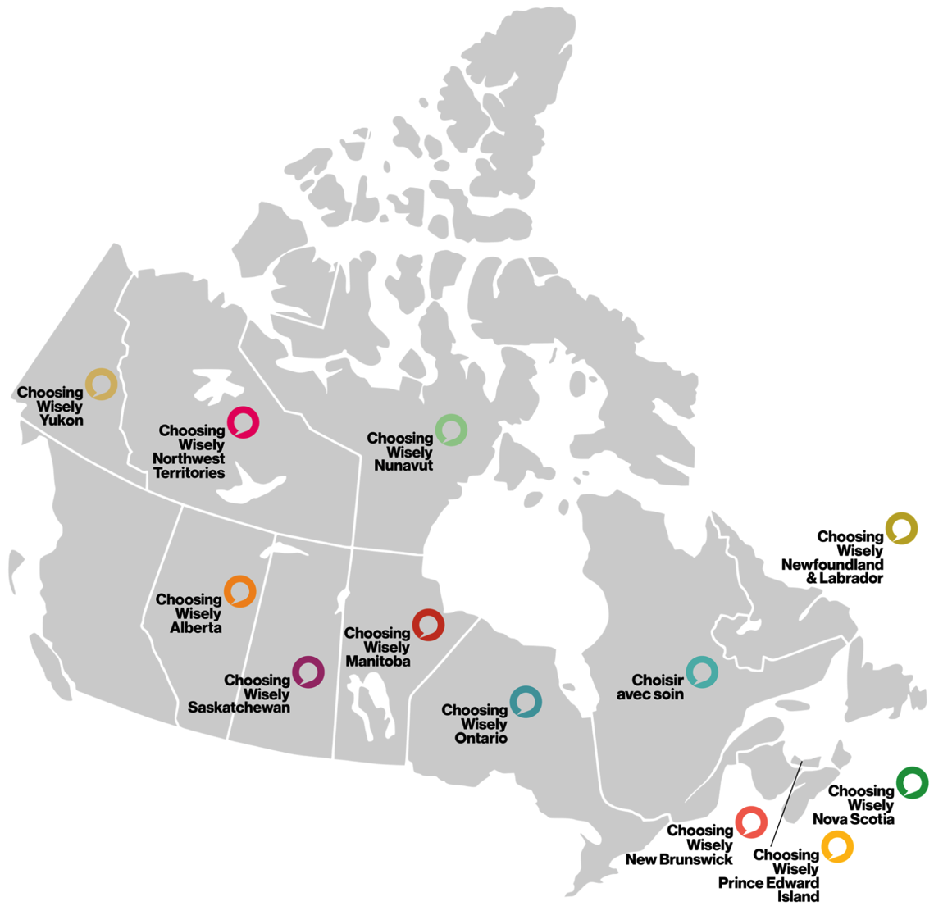
Choosing Wisely Canada
Notes:
Across the country, almost all provinces and territories are now involved and we have our own regional teams coordinating the work of raising awareness of appropriateness of care and supporting implementation of practice improvement related to Choosing Wisely recommendations.
Saskatchewan joined the campaign in May of 2017 and it is the provincial branch of CWC.
CWSK is dedicated in promoting health awareness and encouraging informed and meaningful discussion between healthcare providers and the patients.

Slide 8
What we do
1
2
3
4
Clinician Engagement
Build a culture of reducing low-value care across all stages of professional practice and relearning.
Implementation
at Scale
Catalyze the widespread adoption of evidence-informed practices that minimize overuse across health care settings.
Advocacy & Patient Engagement
Influence societal and systematic dimensions of overuse through public awareness and policy change.
Measuring Impact
Advance measurement and evaluation of overuse and its effect on different segments of the population.
Notes:
These are four areas of our focus and in each, I will provide one or two related examples. Let’s unfold each.

Slide 9

01
Clinician Engagement
Building a culture to reduce overuse
Notes:
In this first pillar, our focus as we engage and support clinicians with different resources or tools, we aim to collectively build a culture that embraces overuse reduction.

Slide 10
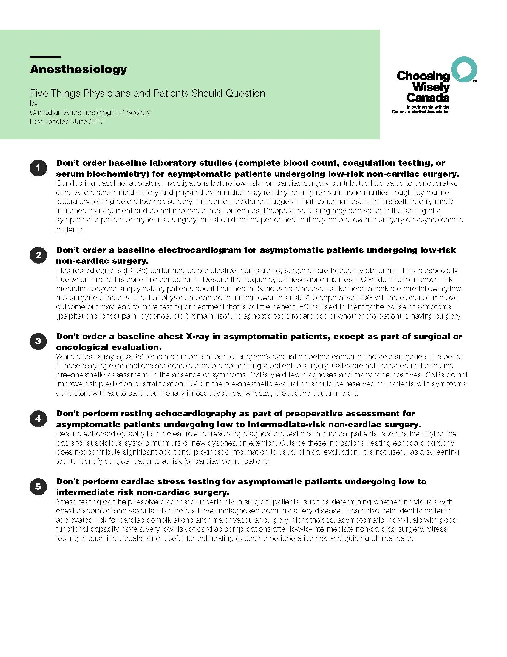
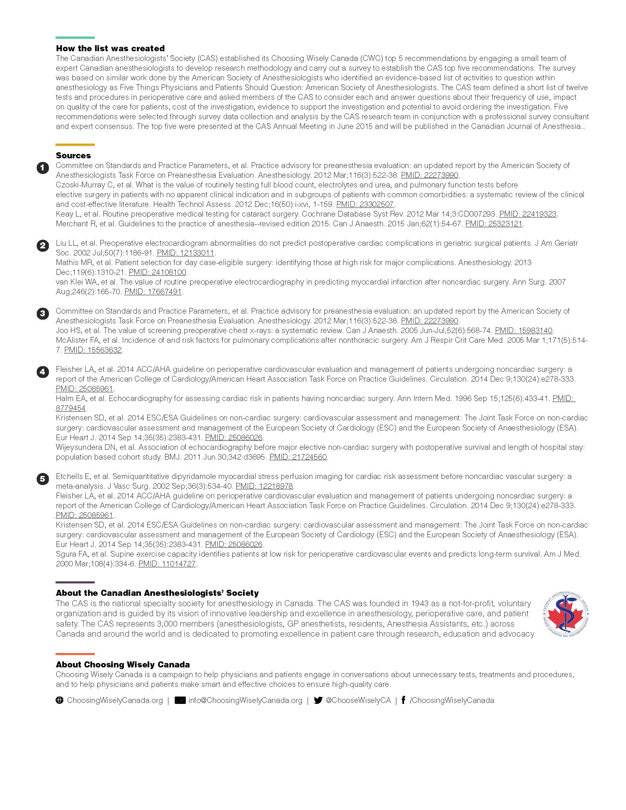
Notes:
Central to the Choosing Wisely Canada campaign are “the lists”. Canadian national societies, representing a broad spectrum of clinicians, participating in the campaign are tasked with developing lists of “Things Clinicians and Patients Should Question.”
These lists contain tests and treatments commonly used in their specialty, but are not supported by evidence, and/or could expose patients to unnecessary harm.

Slide 11

Students and
Trainees Advocating for Resource Stewardship (STARS)
Inspiring the next generation
of physicians in resource stewardship.
Notes:
Choosing Wisely Canada has engaged medical students, residents, faculty, universities, professional organizations and regulatory bodies to embed resource stewardship principles into medical education.

Slide 12
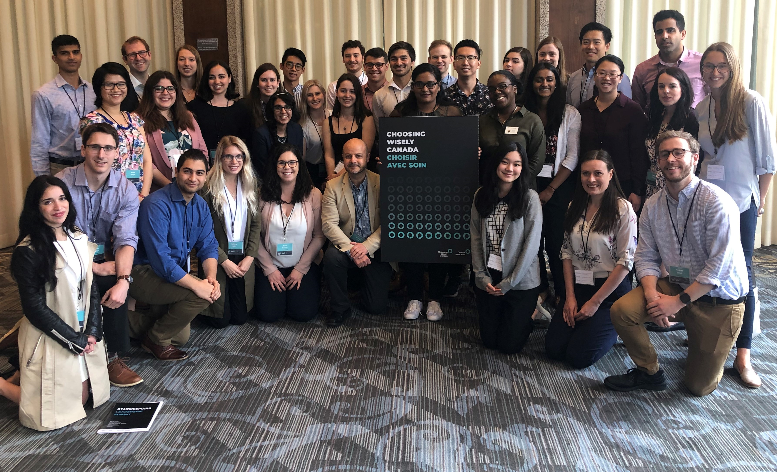
STARS STUDENTS
Notes:
STARS is a grassroots medical education campaign that supports student-led efforts to advance resource stewardship awareness and education.

Slide 13
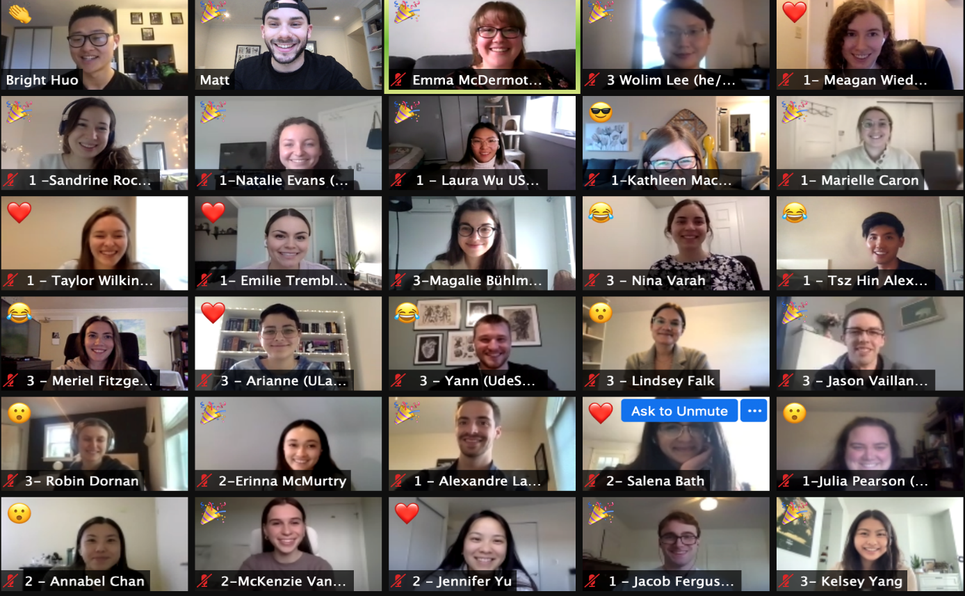
STARS STUDENTS
Notes:
STARS leaders and interest groups are present at all 17 medical schools in Canada. To date, nine student cohorts have participated and involved over 300 medical student leaders.
Sessions as such provide an opportunity for currently enrolled medical student leaders to access information, connect with other medical student leaders, and get the latest updates from the program.

Slide 14

Choosing Wisely & Climate
Notes:
Now, let’s talk a little bit about climate and Choosing Wisely.

Slide 15

Unnecessary tests and treatments
expose patients to potential harm,
consume precious health care resources,
and contribute to the climate crisis.
Notes:
The environmental toll of unnecessary healthcare intervention is often overlooked. Think about the footprint of healthcare intervention throughout the lifecycle – from production, distribution as part of transportation, and disposal of medical equipment and medications! All together, contribute to healthcare sector’s carbon footprint, exacerbating climate crisis.
This is concerning and so, minimizing unnecessary healthcare intervention is not only about preserving resources and protecting patients – its also about reducing our collective environmental impact.

Slide 16
Choosing Wisely Canada
Develops recommendations with national clinician societies on tests
and treatments that do not add value
to patient care
Develops QI tools/programs
to mobilize health care providers
and organizations to tackle overuse
Notes:
In response to such challenges, CWC work with national clinician societies to develop recommendations on unnecessary tests, treatments and procedures aiming to improve patient care. We also create quality improvement tools and programs to help and support healthcare providers and organizations reduce overuse and outcomes.

Slide 17

Climate Conscious Recommendations
Over 40 climate-conscious recommendations, developed by 20+ clinician societies that aim to improve planetary health without compromising patient care.
www.choosingwiselycanada.org/climate
Notes:
We will skip this but there are available resources surrounding climate which you get familiar with at a later point depending on your interest.

Slide 18

02
Implementation at Scale
Catalyze the widespread adoption of evidence-informed practices
Notes:
There are number of ongoing projects across the country at large scale and one of them is Using Blood Wisely.

Slide 19
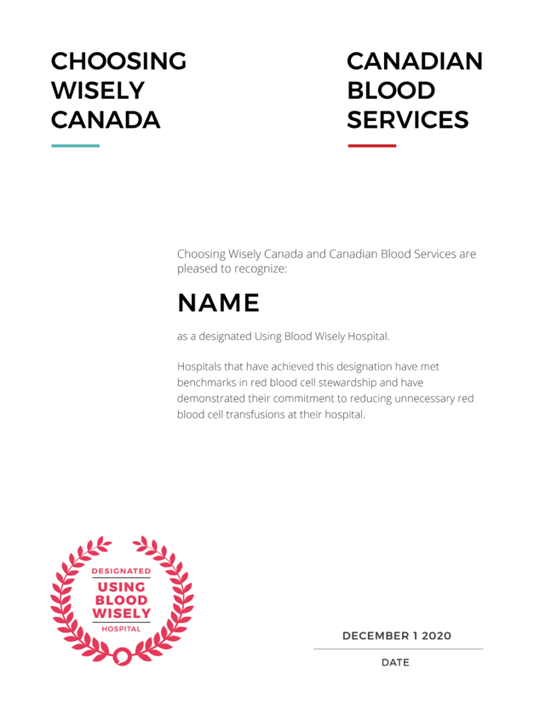
BLOOD PROGRAM
Using Blood Wisely
A concerted effort to strengthen
Canada’s blood supply.
www.usingbloodwisely.ca
Notes:
This is a national campaign and effort to reduce inappropriate blood transfusions through engagement with hospitals.

Slide 20
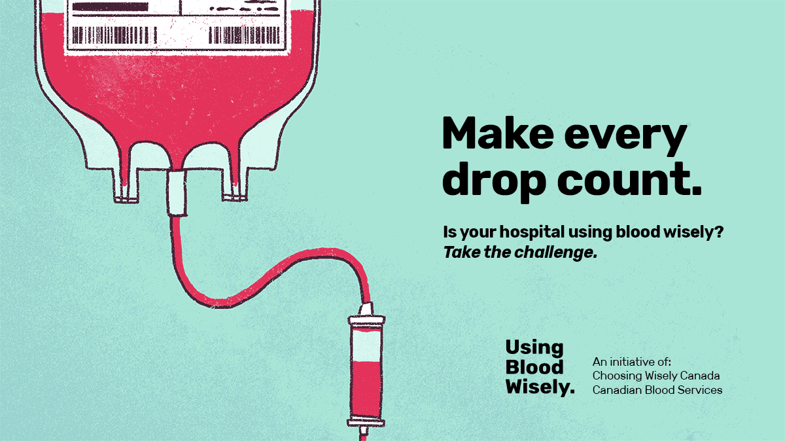
Notes:
Hospitals are engaged with a simple “challenge”. The challenge involves conducting a spot audit of recent red blood cell transfusions in their hospital in comparison to the required benchmarks

Slide 21


Benchmarks
  At least 65% of red blood cell transfusion episodes are single unit, and
  At least 80% of inpatient red blood cell transfusions have a
  pre-transfusion Hb 80 g/L or less
Notes:
These percentages represent the guiding benchmarks and are parts of the quality improvement initiative proven to reduce inappropriate transfusions and qualify for designation.

Slide 22


Notes:
One of the designation on Using Blood Wisely by Choosing Wisely Canada and Canadian Blood Services.

Slide 23
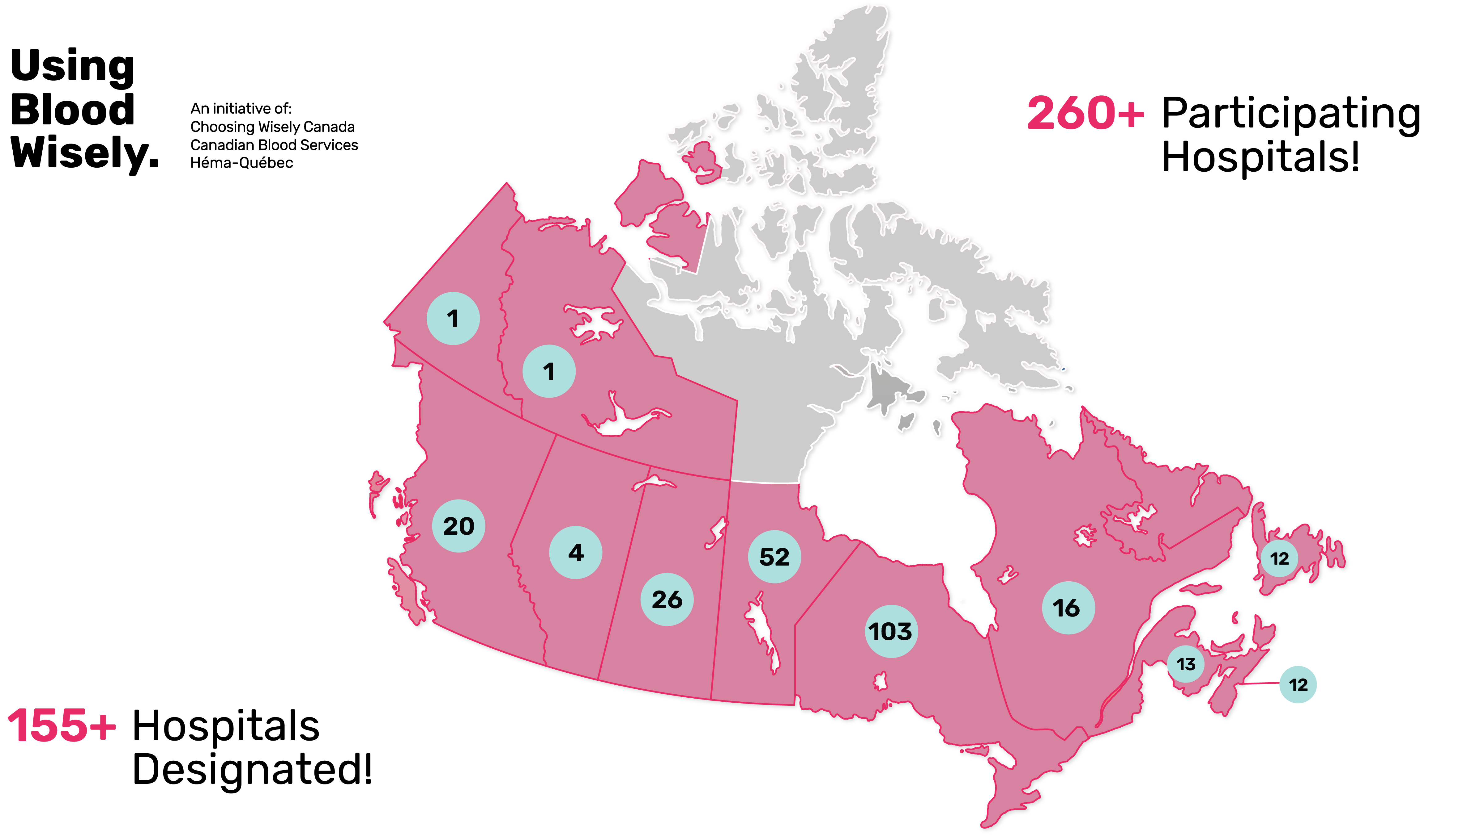
Notes:
Currently there are more than 260 hospitals country-wide participating in using blood wisely while 155+ have been designated.

Slide 24
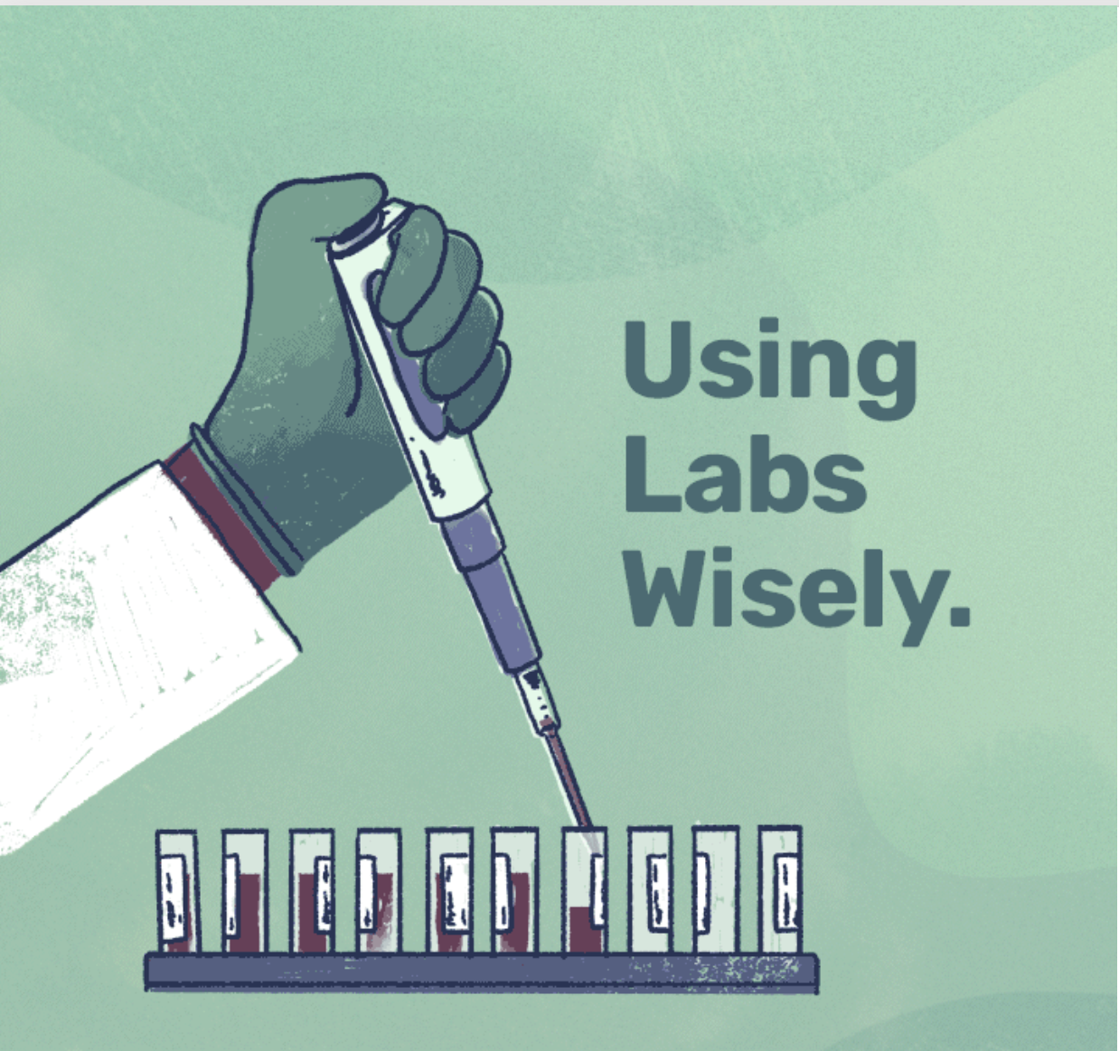
LABS PROGRAM
Using Labs Wisely
A national consortium that’s changing the lab utilization landscape in Canada.
www.choosingwiselycanada.org/labs
Notes:
Another CW national large scale project is Using Labs wisely. This project has played a vital role in curving lab utilization countrywide. You can as well access more info using the above link

Slide 25
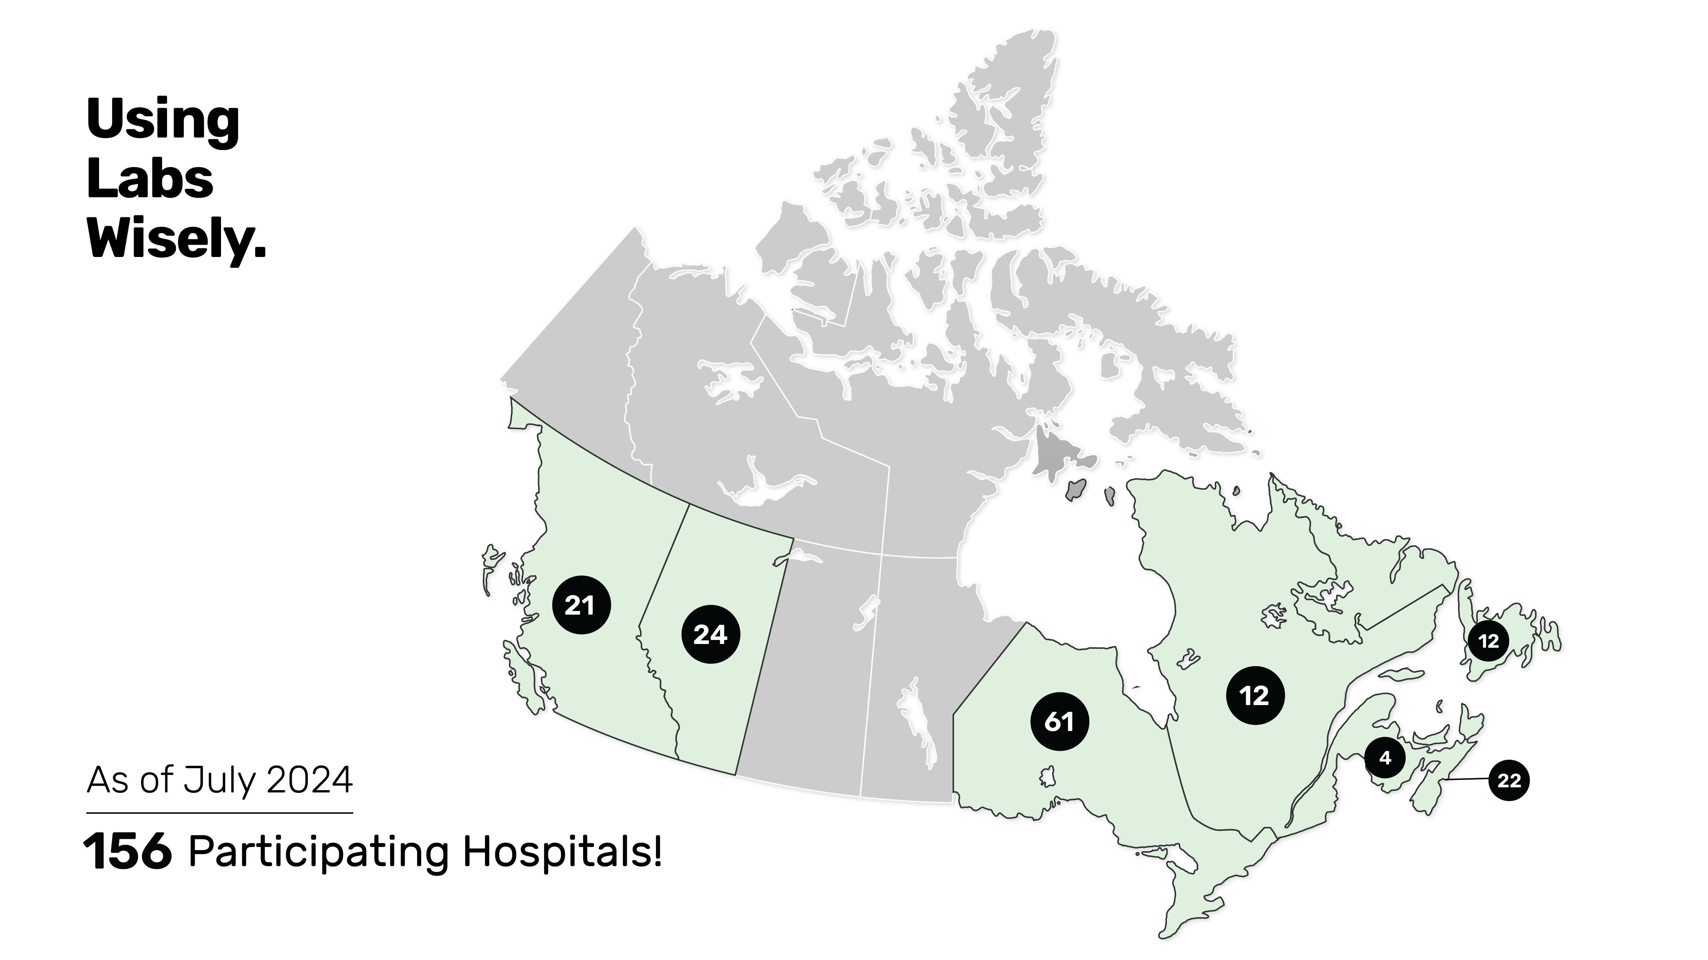
www.choosingwiselycanada.org/labs
Notes:
As of July 2024, 156 hospitals are in participation. I won’t go in detail at this point but if interested, you can access more information through this link.

Slide 26

03
Advocacy and Patient Engagement
Influencing awareness on overuse
Notes:
This is an important pillar when thinking about the outcomes in patient care. Educating patients and encouraging informed discussions with healthcare providers, we can not only reduce unnecessary procedures, tests or treatments but also being in a position to improve outcomes whereby we end up with inclusive outcome including promotion of more efficient healthcare practices.

Slide 27

Time to Talk.
Choosing Wisely Canada encourages conversations between clinicians and patients with serious or progressive illnesses.
Taking the time to talk can help to avoid potentially harmful or overly aggressive tests and treatments that may not align with an individual’s goals and wishes.
Notes:
This is one of the resources CWC develops to promote and emphasize on the importance of clinician-patient meaningful conversation.

Slide 28
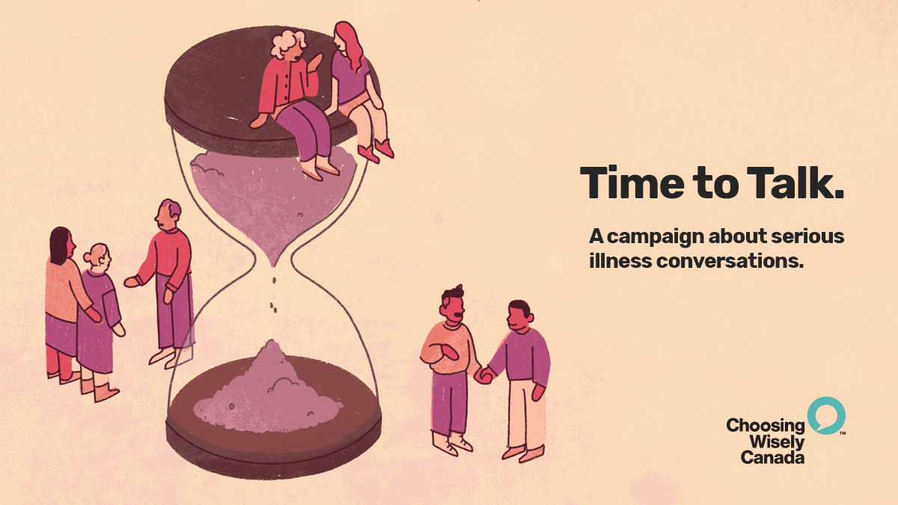
Notes:
This is very important especially for whose patients with serious illnesses.

Slide 29
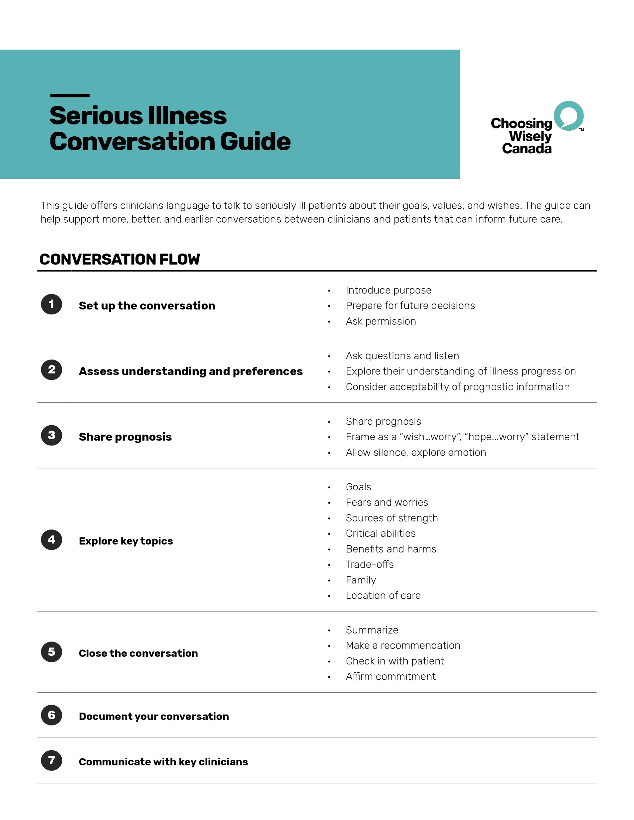
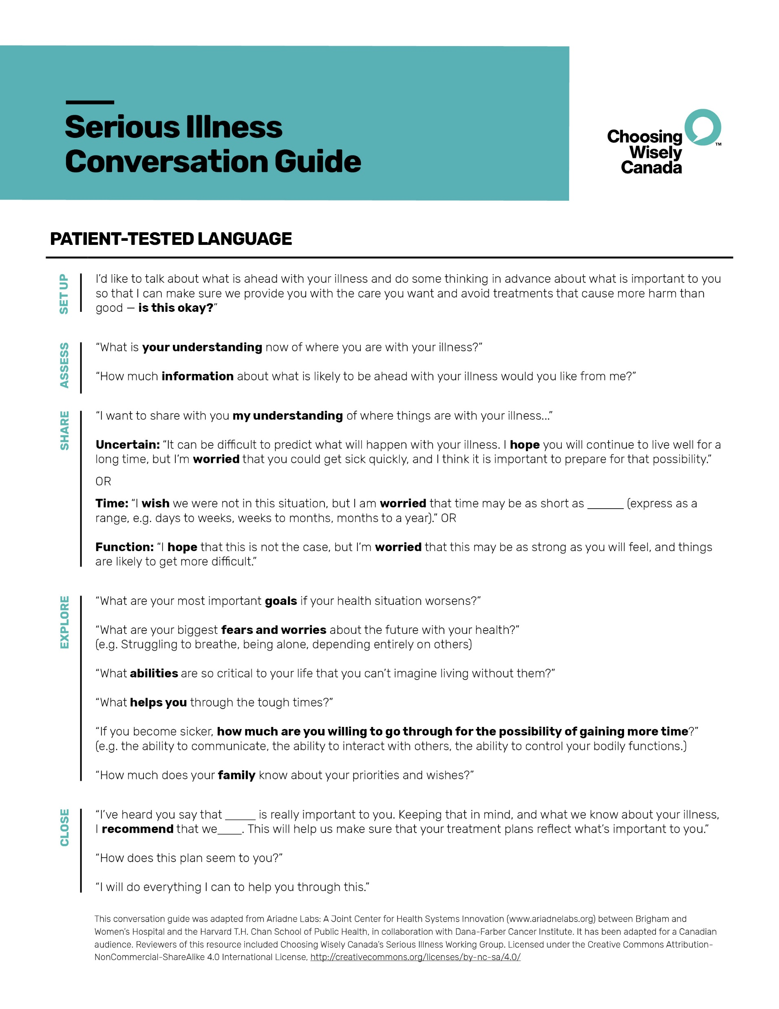
Conversation Guide
Designed to help support better and earlier conversations between clinicians and patients about goals and wishes that can inform future care.
Notes:
This is more of a tool-kit help healthcare providers engage wisely with patients during serious illness related conversations.

Slide 30
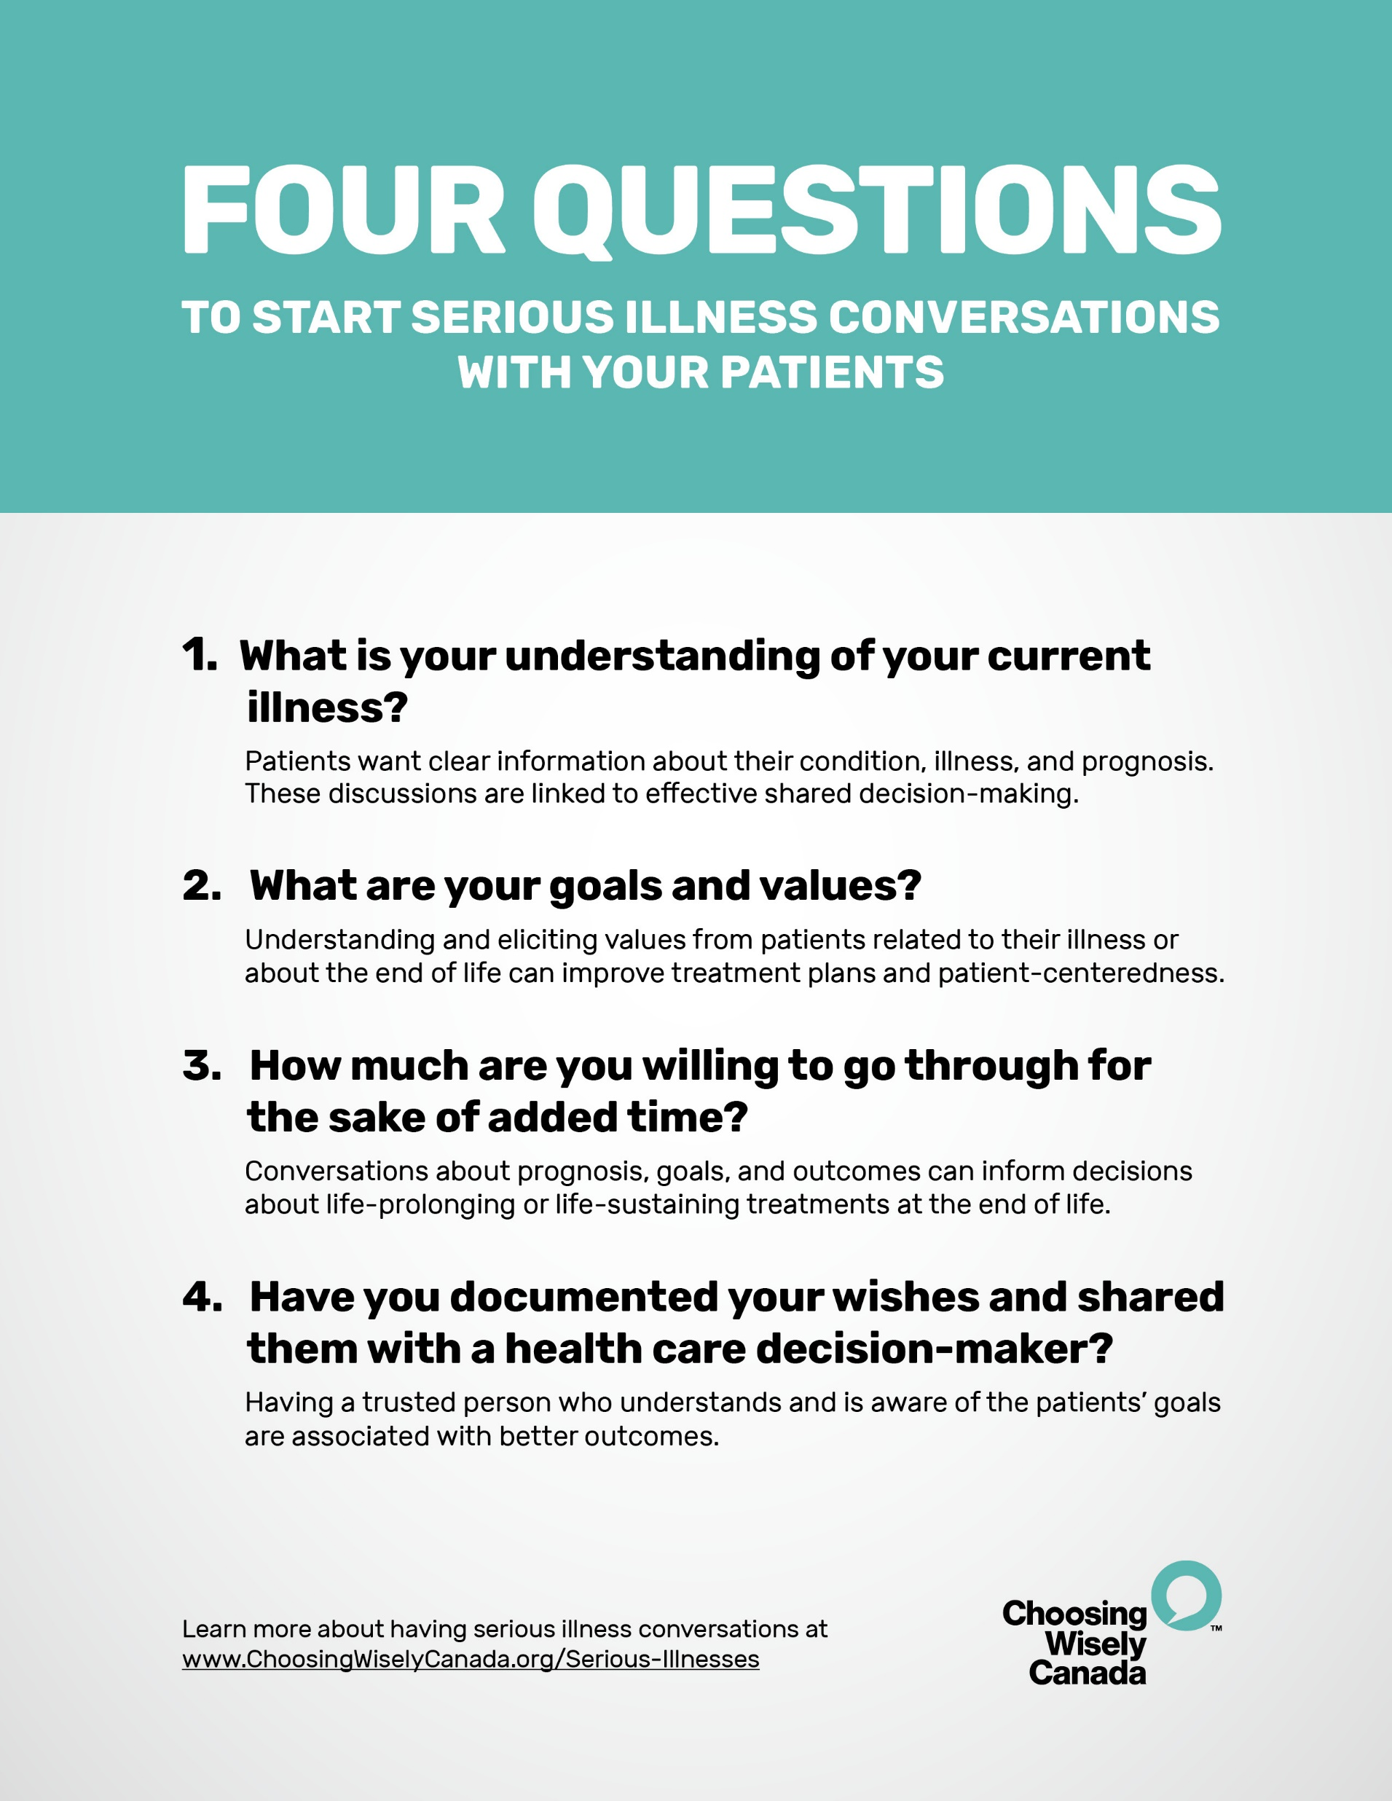
Four Questions
Designed for clinicians to ask patients to start conversations about goals, wishes, and values.
Notes:
Just like the above, this is helpful in guiding and getting some clarities.

Slide 31
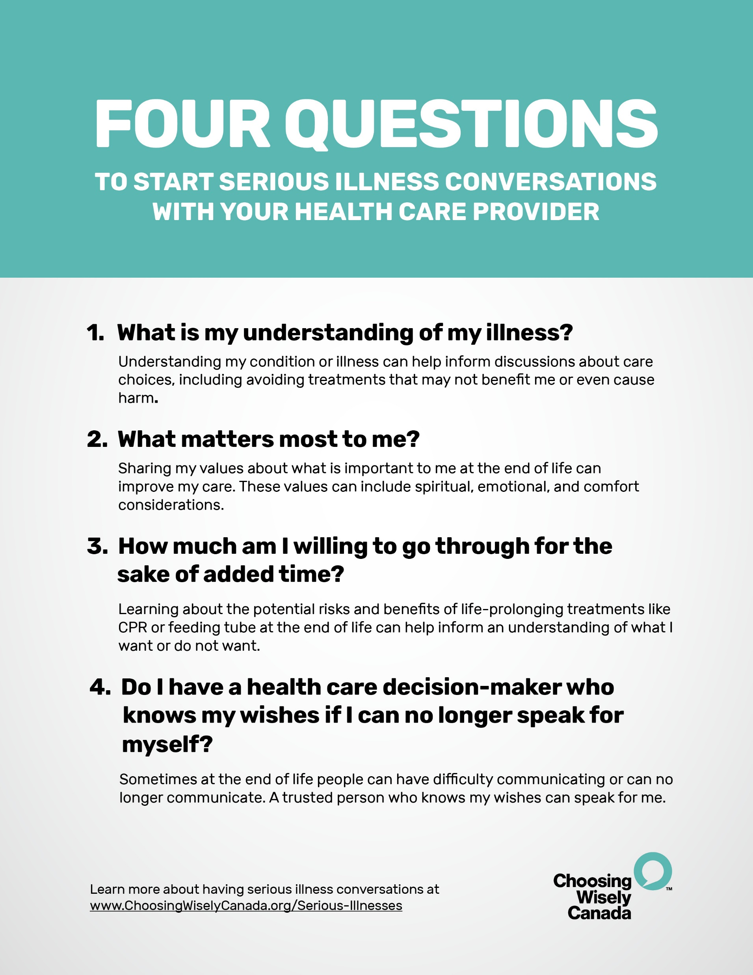
Four Questions
Designed for patients to ask their health care provider to start conversations about goals, wishes, and values.
Notes:
Again like the above but meant for the patients respectively while engaging in conversations with their healthcare providers.

Slide 32
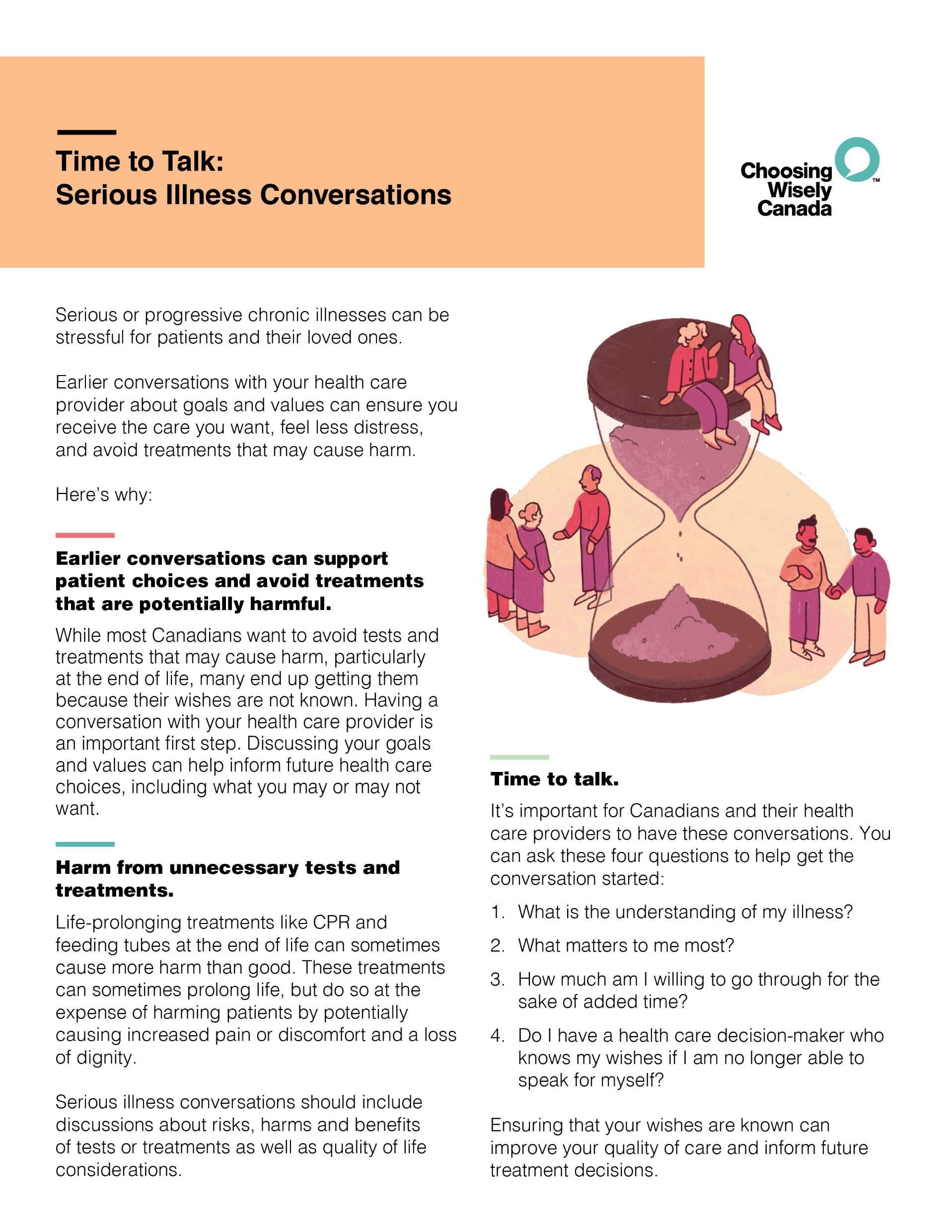
Patient Pamphlet
Designed for clinicians and patients to discuss serious illness conversations.
Notes:
Still same as the above materials.

Slide 33

ANTIBIOTICS CAMPAIGN
Using Antibiotics Wisely
A national effort to encourage conversations between clinicians and patients about unnecessary antibiotic use.
www.choosingwiselycanada.org/antibiotics
Notes:
This is for primary and long-term care providers in regards to reduce unnecessary antibiotic prescriptions.

Slide 34
Posters
https://choosingwiselycanada.org/recommendations/
Notes:
There are many other related posters in CW website and some have been translated into top five spoken languages in Canada.
A resource for both audiences – public can ask questions, clinicians can use it as a means to discuss overuse and unnecessary overuse.

Slide 35

Notes:
To raise awareness among the patients and public, CW launched the More Is Not Always Better campaign
This includes videos and posters that present patients with scenarios in daily life where more is clearly not better, and make the connection that the same is also true when it comes to medicine. These resources
Promote the message that in medicine as it is in life, “more is not always better”
Educate patients about when they might need a particular test or treatment, and when they don’t
Encourage patients to talk with their doctor about unnecessary care

Slide 36

04
Measuring Impact
Advancing measurement and evaluation of overuse
Notes:
In this last pillar, our goal is to ensure that healthcare interventions are used appropriately – only when necessary – and that patients benefit from care without experiencing unnecessary treatments.
We use combination of qualitative and quantitative approaches to access metrics such as reduced testing rates, patent outcomes, and cost saving. This allows us to evaluate whether CWC recommendations are being followed and where more improvement is needed.

Slide 37


The Impact
Why does this matter…
To patients?
To clinicians?
Notes:
So, reflecting on the volumes of unnecessary tests and treatments, why does this really matter??
What impact does it have on patients and providers, and the health system?

Slide 38
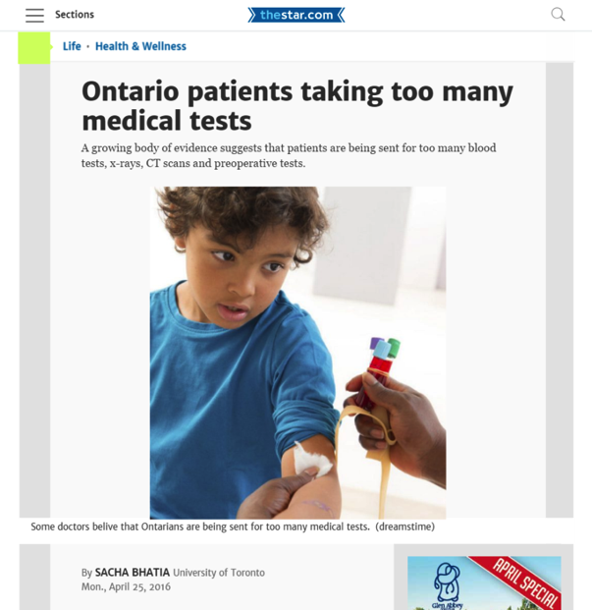
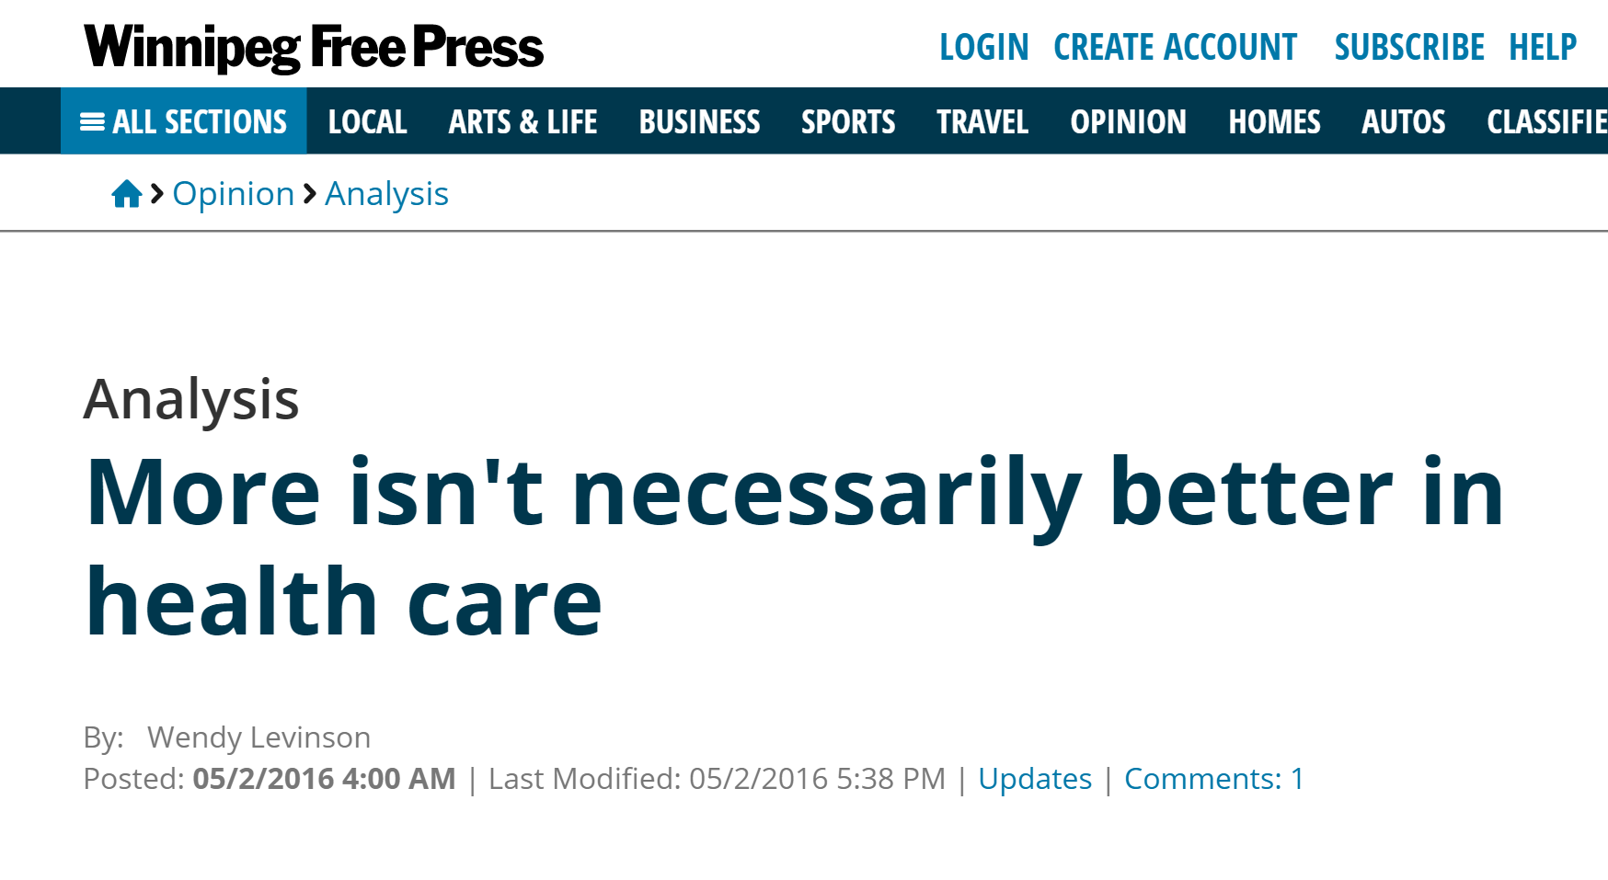
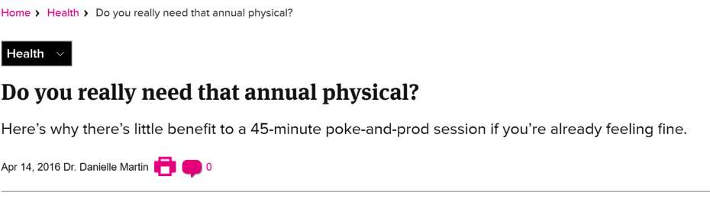

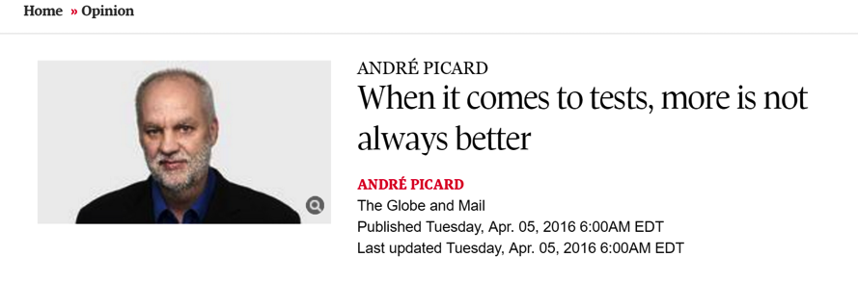
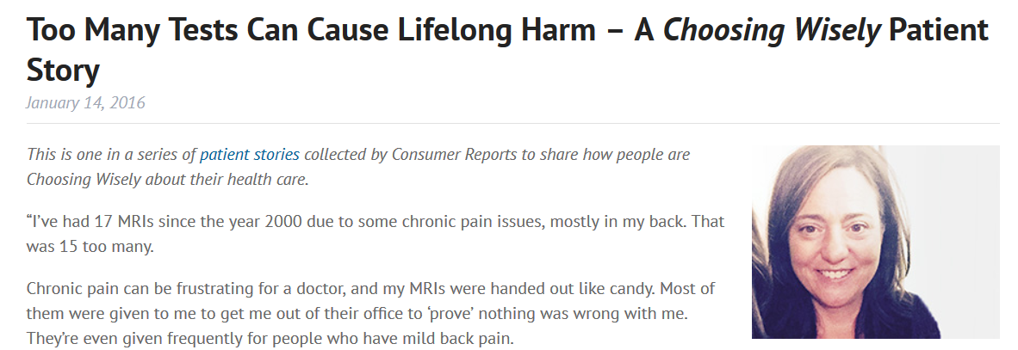


Media
Notes:
We know that "First do no harm" is a guiding principle for providing medical care. Yet even with the best of intentions, we know that harm occurs.
Sometimes patients don’t always receive the most appropriate care, which means they don’t always receive the best treatment options. This can create multiple issues in the health care system, and in some cases take patients down the wrong path or care plan.
ASK: “What types of potential harm do you think could be caused by over testing, or over treating a patient?”
Now let’s begin from somewhere (next slide).

Slide 39

The patient wants it
I’ve always done this
New tests are good
$$
I don’t want to get sued
Better to do something than do nothing
Referring doctor wants it
Notes:
Decision around test requisition and treatment prescription remain a challenge for most of physicians. Factors include:
As you can see, it is not just in the physician hands….. As a result, overuse or unnecessary care occurs.

Slide 40
Patient inconvenience
Antimicrobial resistance
Exposure to unnecessary radiation
Harm from Unnecessary Care
Medication side-effects
False positives
Patient anxiety
Notes:
This diagram outlines some of the most common forms of harm from over-treatment and unnecessary care:
Over-treatment and unnecessary care can lead to serious harm, including medication-related risks like falls or addiction, excessive radiation exposure from imaging, and anxiety from false positives in screening tests.
On a broader level, this contributes to antimicrobial resistance and longer wait times for those in need of urgent care.

Slide 41

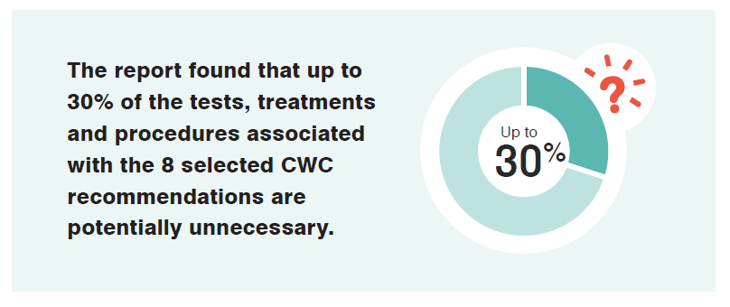
First Report (2017)
Notes:
In 2017 a report titled Unnecessary Care in Canada, was released by Choosing Wisely Canada and the Canadian Institute for Health Information (CIHI)
This report was based on administrative data and looked at the extent of unnecessary care associated with tests and procedures; that span across the health system from primary care, specialist care, Emergency department care and hospital care.

Slide 42
Unnecessary?
Too much medicine
Over treatment
Over testing
Low value care
Over diagnosis
Over utilization
Unnecessary use of health resources and procedures that are not supported by evidence, or that may be duplicate of other tests previously done—care that can lead to harm and doesn’t improve outcomes for patients
Notes:
When we talk about unnecessary – what do we mean? Let’s unpack that a bit.
The term “Unnecessary” in this context means use of health resources and procedures that are not supported by evidence, or that may be duplicate of other tests previously done—care that can lead to harm and doesn’t improve outcomes for patients.
As mentioned earlier, Choosing Wisely Canada works with the professional medical societies to determine the criteria for when a test, treatment or procedure would be required and when it wouldn’t – these decisions are backed by evidence.

Slide 43
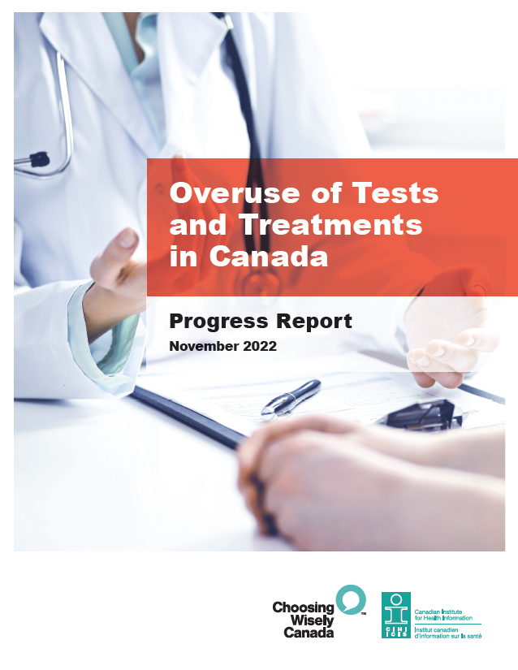
Second Report (2022)
Has Canada made progress in reducing overuse?
https://choosingwiselycanada.org/initiatives
Notes:
3 products: Progress report, data tables, methodology notes
12 tests, treatments, and procedures related to CWC recommendations across Community, Emergency and Hospital Care settings
Trends + variation across provinces/territories
Taking action: Initiatives and success stories on curbing overuse https://choosingwiselycanada.org/initiatives

Slide 44
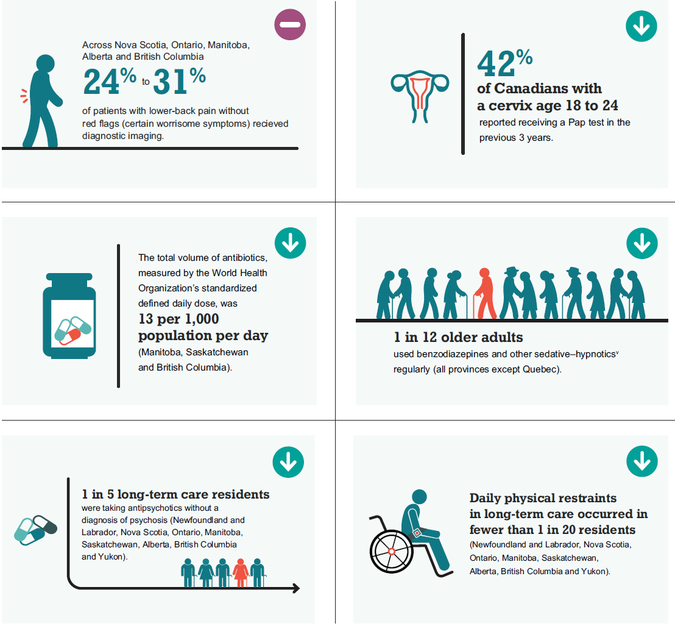
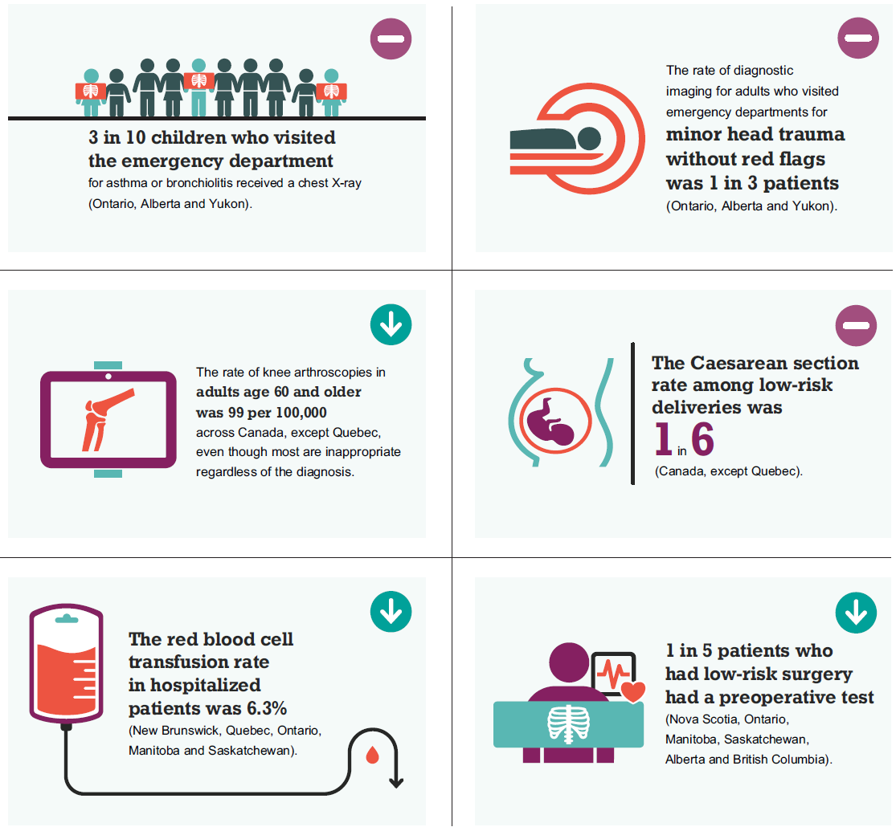
8 of the 12 tests and treatments declined by 10% or more between 2014–2015 and 2019–2020
Notes:
Canada has made progress on 8 of the 12 areas we examined
Today we will focus on 2 indicators for long-term care: antipsychotics and physical restraints

Slide 45

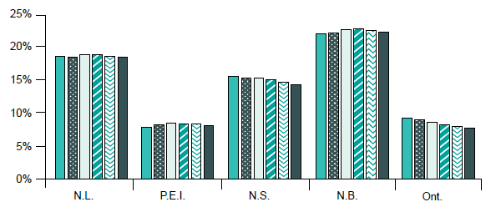
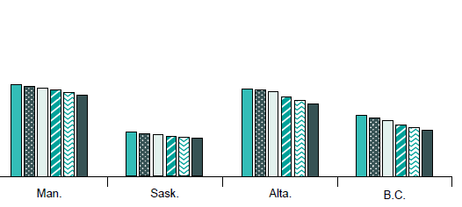

Rates of chronic use of benzodiazepines and other sedative–hypnotics declined across most jurisdictions
Notes:
If all jurisdictions could achieve rate of lowest province (SK, 5.5% in 2019-2020), an additional 150,000 fewer older adults would use BSH frequently in one year

Slide 46
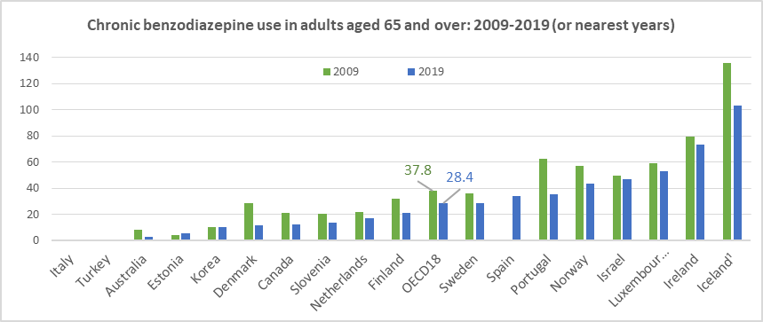
Rates of chronic benzodiazepine use are declining across 18 OECD countries
Per 1 000 population aged 65 years and over
Source: OECD Health Statistics 2021. ¹Three-year average.
Notes:
Note: The OECD indicator methodology is different from ours; Canada’s rate is below the OECD average

Slide 47
In the first 2 years of the pandemic, rates of antipsychotic use in long-term care residents without psychosis increased
Source: CIHI, Your Health System
%
*
What’s behind this rise and how might we tackle this complex problem in LTC settings?
All results are based on data collected using the Resident Assessment Instrument–Minimum Data Set 2.0 (RAI-MDS 2.0), except for Saskatchewan’s results for 2020-2021 and 2021-2022, which are based on interRAI Long-Term Care Facilities (InterRAI LTCF).
* 2019–2020 results for Saskatchewan are not shown due to the transition from RAI-MDS 2.0 to InterRAI LTCF during this year.
Notes:
I will skip this transition difference and we look into some of our provincial-wide ongoing projects (Next slide).
SK transitioned from RAI-MDS to InterRAI LTCF assessment instrument in 2019-2020. Performance (based on comparison and trend results) and top results are not reported at this time for jurisdictions that use the interRAI LTCF.
The LTCF collects more comprehensive information on antipsychotics and restraint use, which contributes to the higher rate in SK during 2020-2021 and 2021-2022..
The pan-Canadian rate was 20.2% in 2019-2020, and increased to 22.1% and 23.9% in 2020-2021 and 2021-2022, respectively

Slide 48
Current CW initiatives in SK
Antimicrobial Stewardship in Acute Care
Antimicrobial Stewardship in Primary Care
Antimicrobial Stewardship in LTC
Opioid Stewardship Program
Using Blood Wisely Appropriateness of Red Blood Cell transfusion:
Appropriateness of IV Immune Globulin
Appropriateness of Subcutaneous Immune Globulin
Appropriateness of C-Sections
Appropriateness of Thyroid Function Tests
CPCSSN Canadian Primary Care Sentinel Surveillance Network
Appropriateness of Food Allergy Screening Tests
Notes:
This is a list of some Choosing Wisely related initiatives that are currently ongoing in our province (SK).
Contact us to collaborate or learn more about any of them. Also, we welcome any other ongoing projects within the region in association with CW recommendations

Slide 49

To Learn More
https://choosingwiselycanada.org
https://www.saskhealthauthority.ca/choosing-wisely-saskatchewan
Notes:
Choosing Wisely Canada website is a source of a lot of information. The recommendations are listed by specialty or health concern.
Under the events link you will find information about both past & upcoming webinars or events and learning opportunities as well.

Slide 50



Thank you/Merci
Contact:
Email: cwsk@saskhealthauthority.ca
Stephen.Odoi@saskhealthauthority.ca
Office: +1306-776-4671
Cell: +1306-551-8608
@Choosewiselysk
@choosewiselysk
@ChoosingWiselySakatchewan
Notes:
Once again, if you are interested or want to learn more about mentioned projects including any relevant feedback, contact or reach out using one of our communication means.
Thank you so much for your time and listening.

